Slide 1


Scalable Databases: Final Project
PHONE CALL LOGS
Made by:
Rasika Gulhane
Group Member:
Rasika Sanjay Gulhane
Tirth Bhat
Guided By:
Prof. Kaleema

Slide 2
Why Neo4j?
Neo4j because it is one of databases that works with NoSQL data for graphical representation. It shows the graph that contains nodes and relationships between these nodes, also nodes and relationships may have additional attributes called properties that describe them in more detail.
Our project shows Telecom database and it is all about connection and graphs in various aspects of its operations., which makes graph databases a perfect fit to model, store, and query any type of telecommunications data.
Notes:
City is from Thailand country

Slide 3
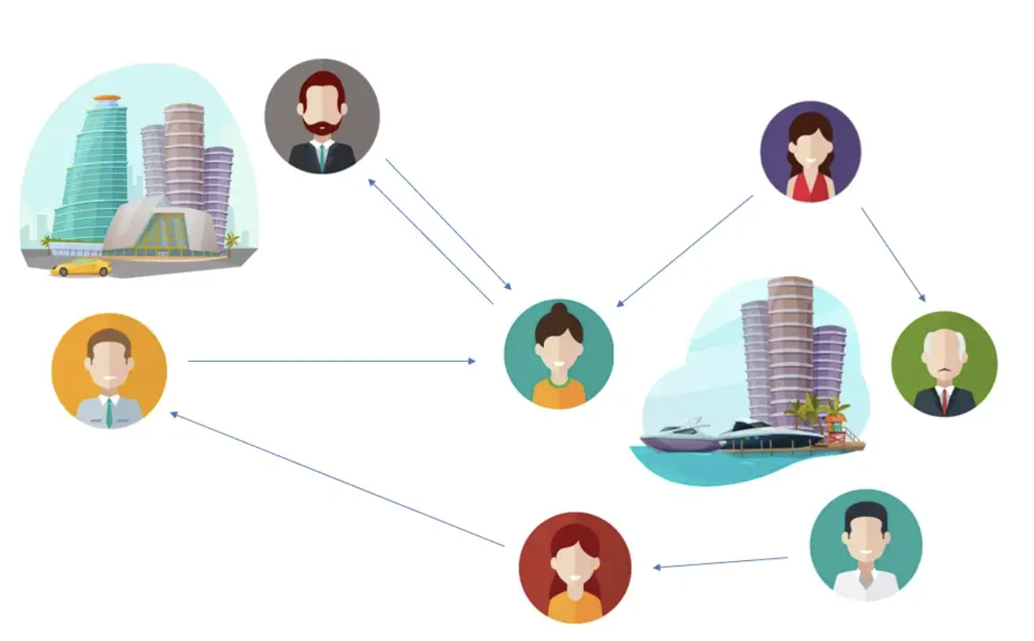
Project Description
The database shows calling information of Thailand country i.e “a call log” of people living in different cities. There are 3 nodes and each nodes represented as Person, City and Calls.

Slide 4
Description of Attributes:
Let say Person(1) is caller and Person(2) is receiver
From name: Name of caller, Person(1)
From gender: Gender of Person(1)
From city: City from where person(1) is making call
From date: DateTimeStamp of call made by Person(1)
From number: Calling number of person(1)
To name: Name of call receiver, Person(2)
To gender: Gender of Person(2)
To city: City from where Person(2) receives the call
To date: DateTimeStamp of call made by Person(2)
To number: Calling number of person(2)
P1
P2
Caller
Receiver

Slide 5
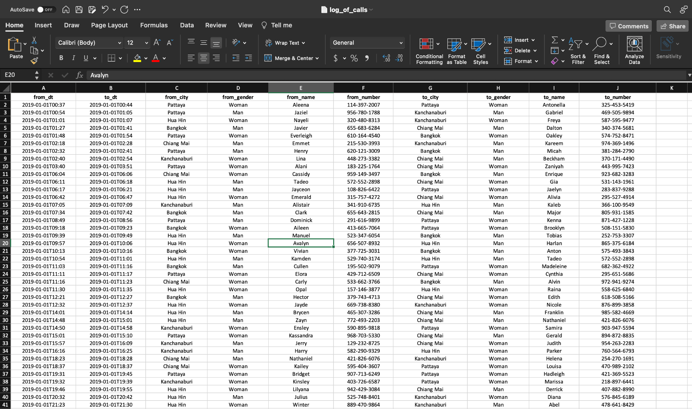
CSV file with attributes:

Slide 6
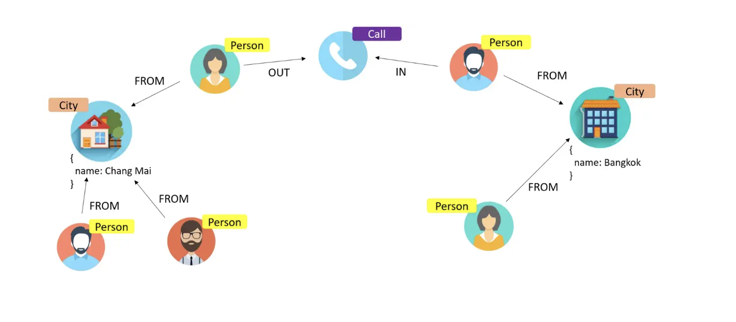
Normalization
As you can see, currently, we have city property inside the Person node.
This structure leads to data duplication and potential problems with inconsistency. Much better design to have each City as a separate node with relationship from each person, who living there.

Slide 7
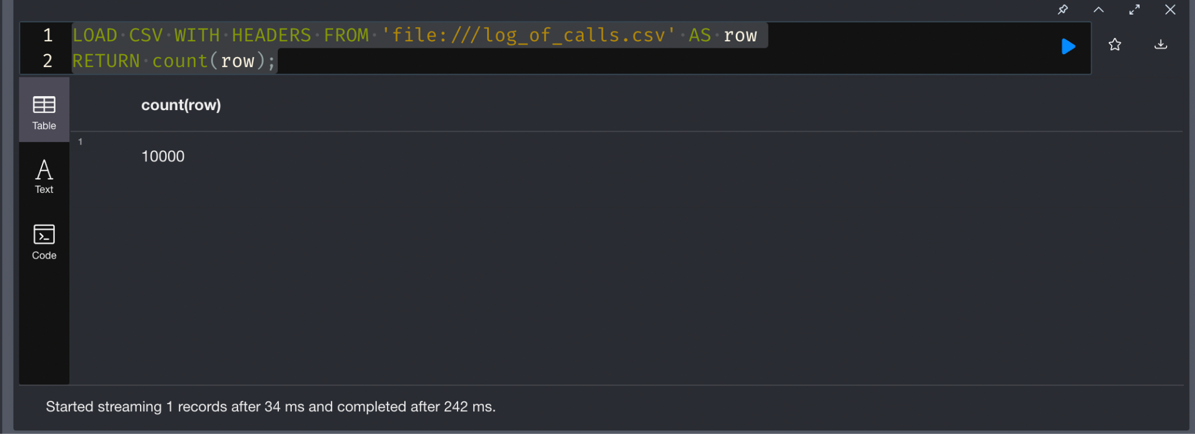
Loading the Data in Cypher
Loading CSV to Cypher
LOAD CSV WITH HEADERS FROM 'file:///log_of_calls.csv' AS row
RETURN count(row);

Slide 8
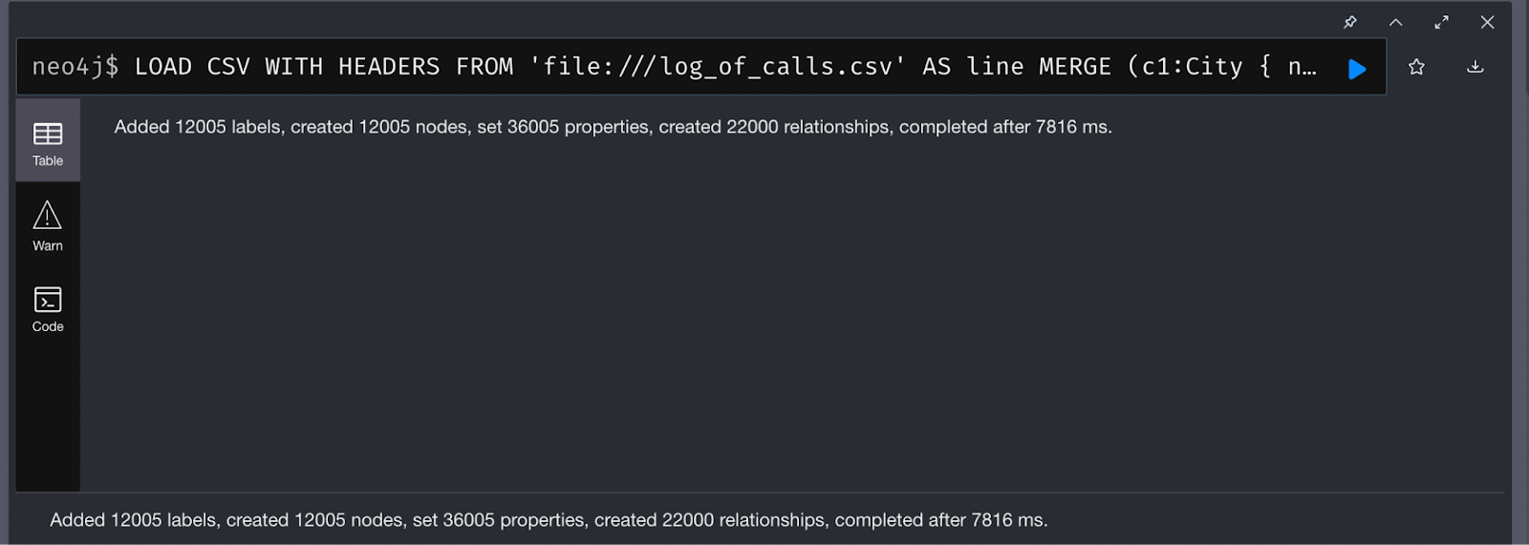
Defining and merging nodes along with their relationship
LOAD CSV WITH HEADERS FROM 'file:///log_of_calls.csv' AS line
MERGE (c1:City { name: line.from_city })
MERGE (p1:Person { name: line.from_name, number: line.from_number, gender: line.from_gender })
MERGE (p1)-[:FROM]->(c1)
MERGE (c2:City { name: line.to_city })
MERGE (p2:Person { name: line.to_name, number: line.to_number, gender: line.to_gender })
MERGE (p2)-[:FROM]->(c2)
CREATE (c:Call { from: datetime(line.from_dt),
to: datetime(line.to_dt),
duration: duration.between(datetime(line.from_dt), datetime(line.to_dt)).minutes })
CREATE (p1)-[:OUT]->(c)<-[:IN]-(p2);
-Loading
-Merging
-Connection

Slide 9
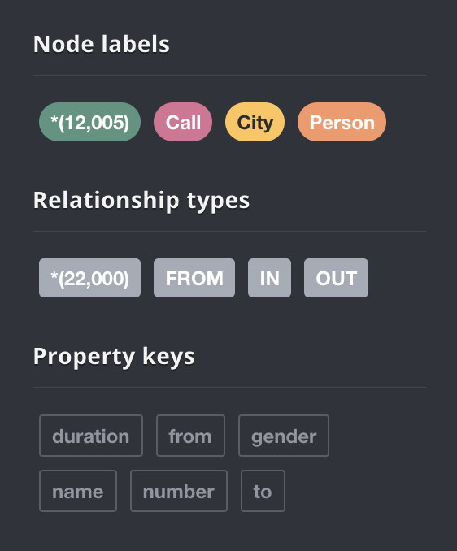
Nodes and Relationship
Nodes are used to store data entities in graph databases, and edges are used to store relationships between them.
An edge can describe parent-child relationships, actions, ownership, etc.
An edge always has a start node, end node, type, and direction.

Slide 10
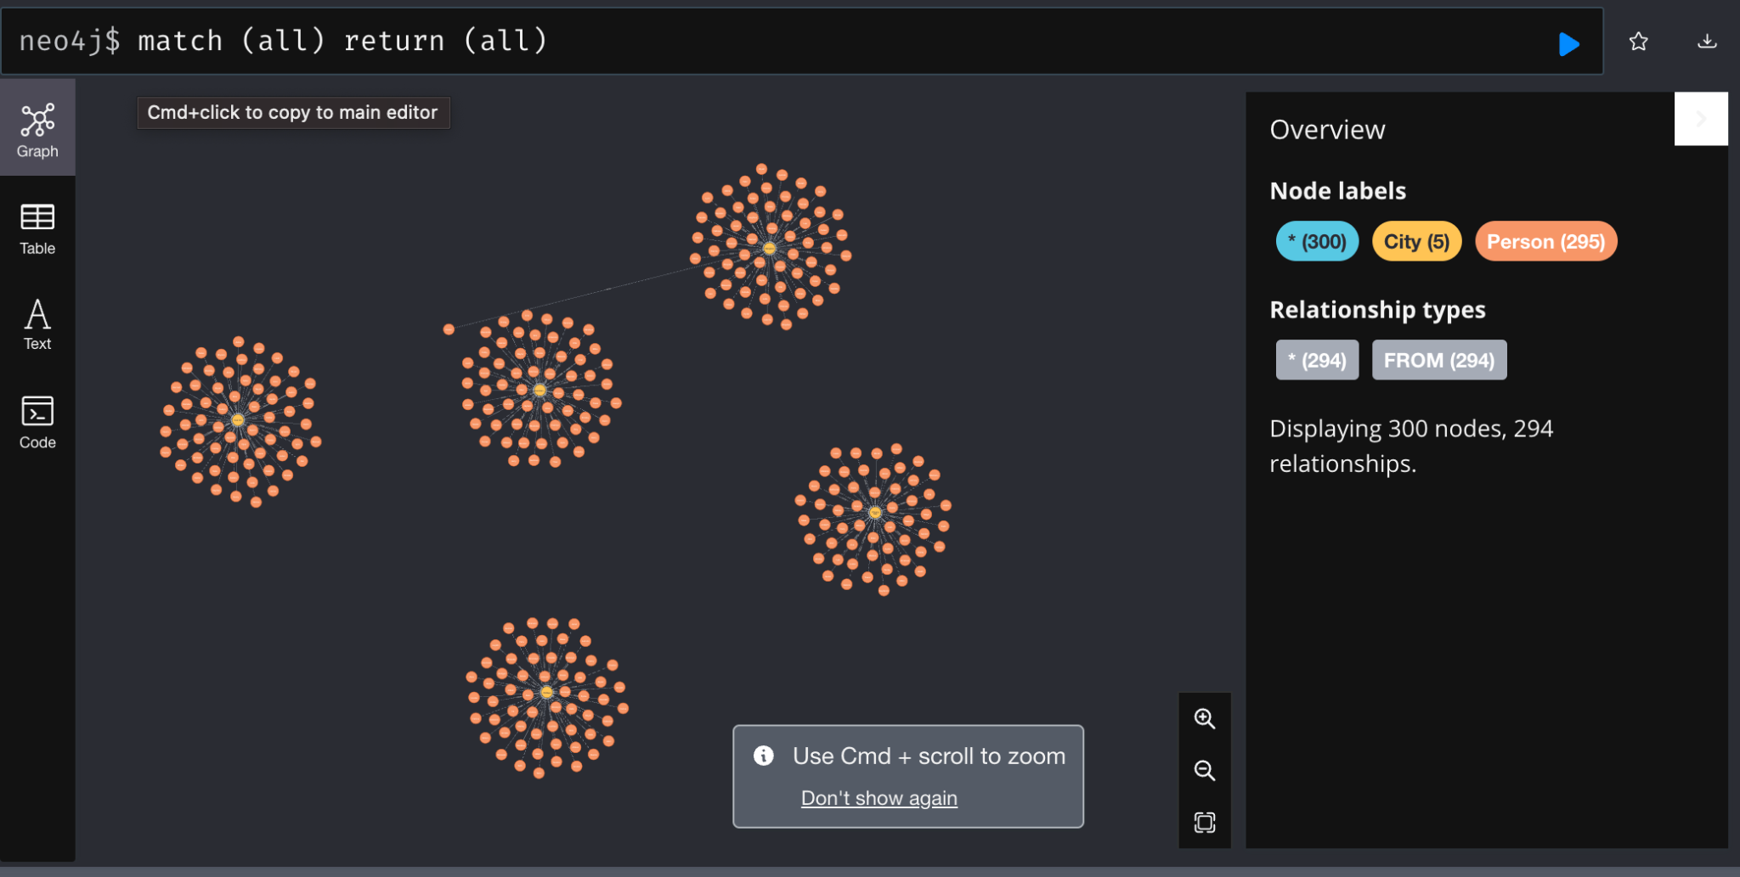
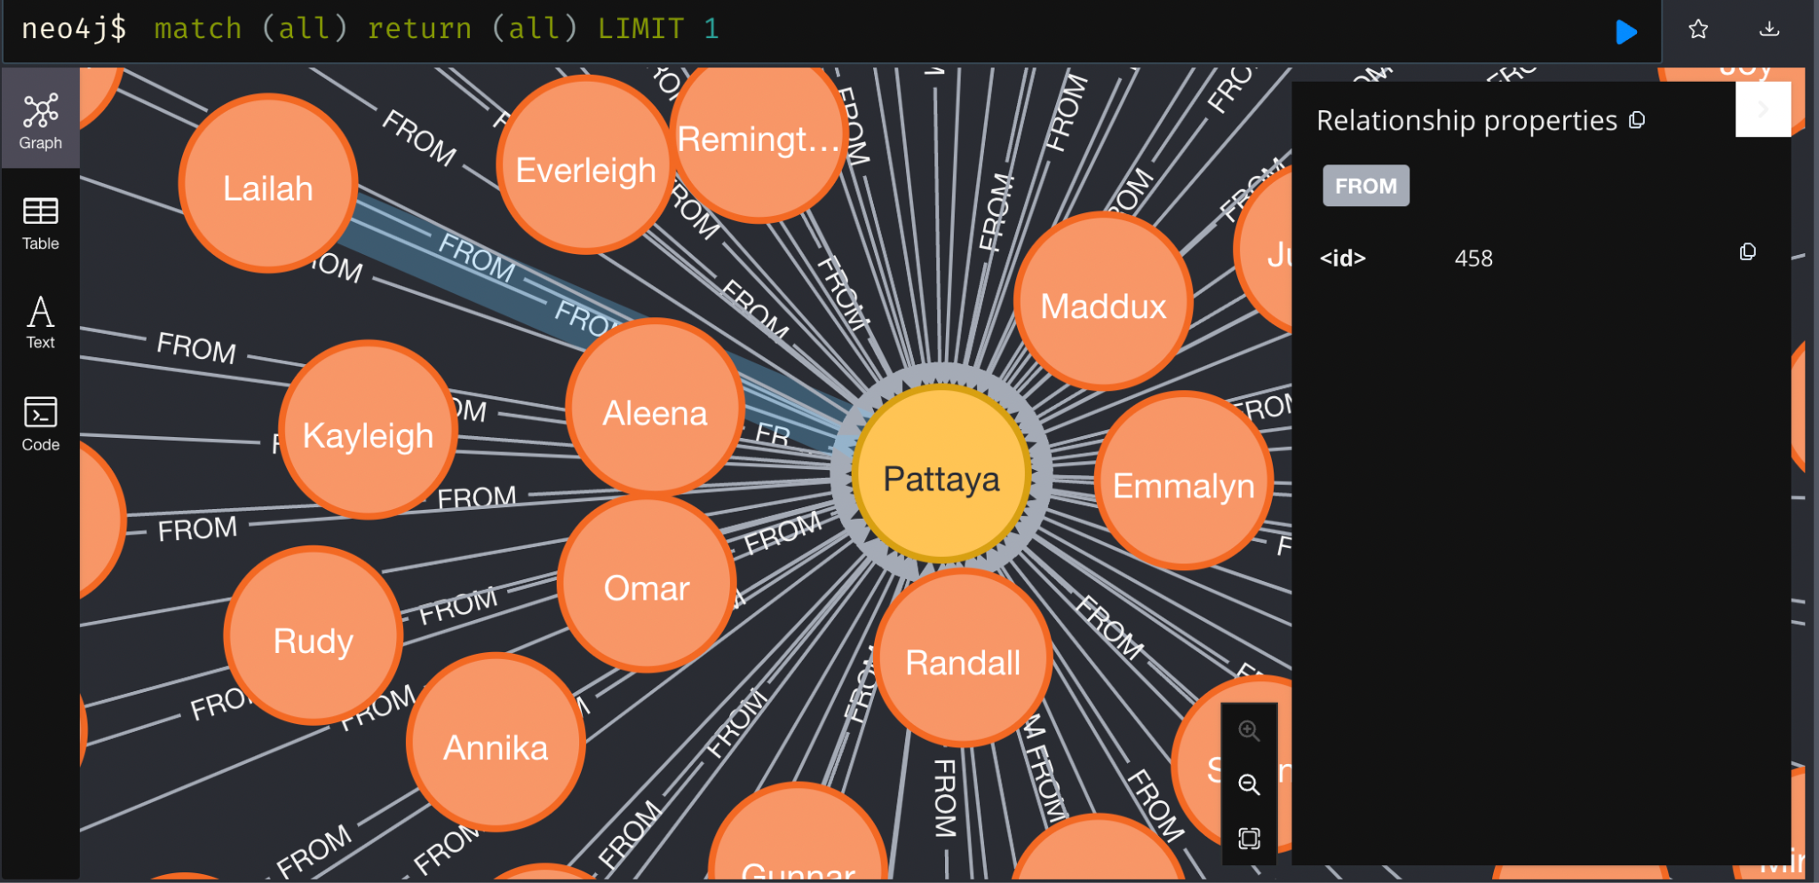

Slide 11
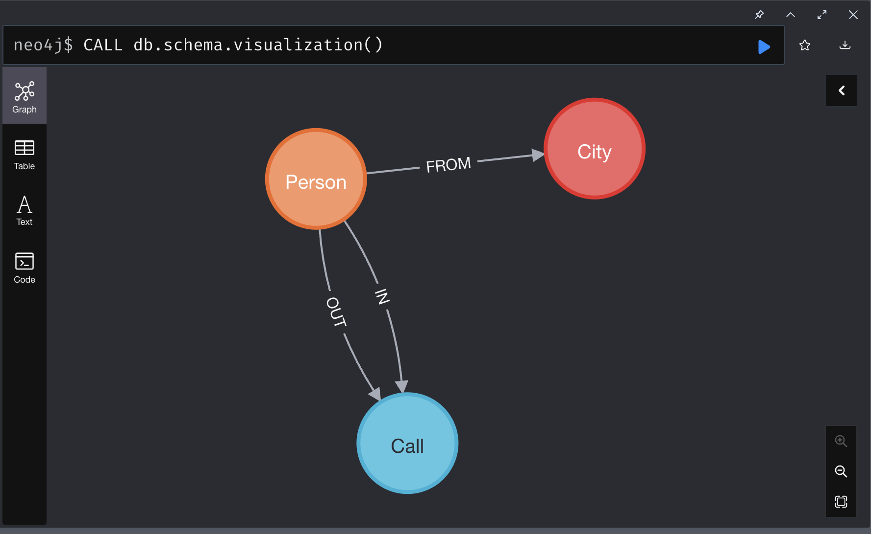
Domain Model
This graph gives us insight of three simple things.
There are some person who are from some cities.
And who calls and receives calls from other persons.
From given call timestamp duration time is also retrieved

Slide 12
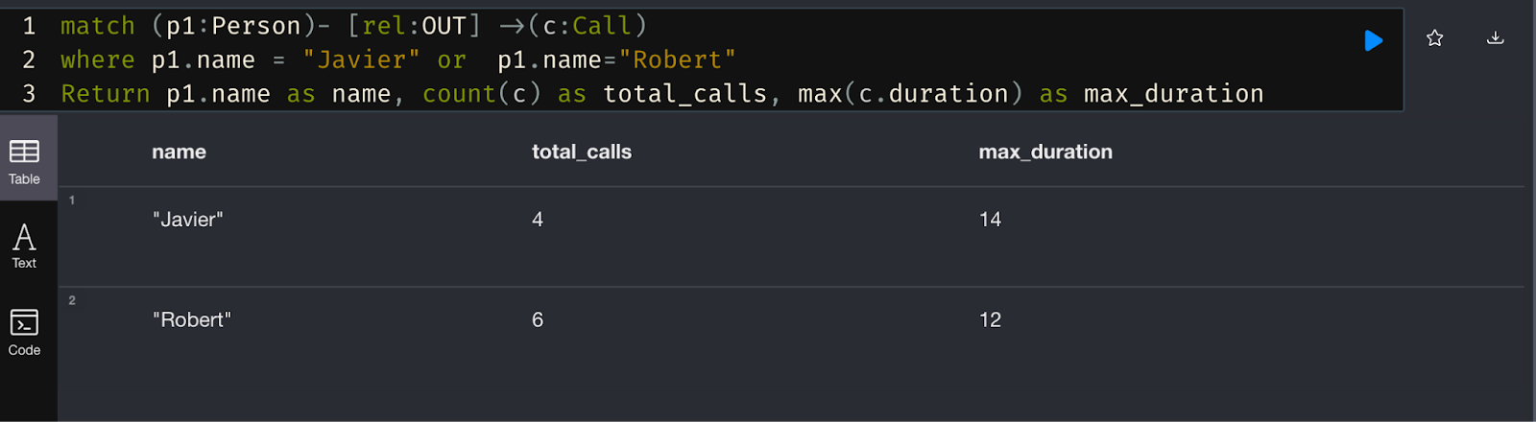
Queries:
Problem
Find the total Outgoing calls made by Javier and Robert and show their highest duration of call
-Relation
-Condition
-Aggregation
count
max

Slide 13
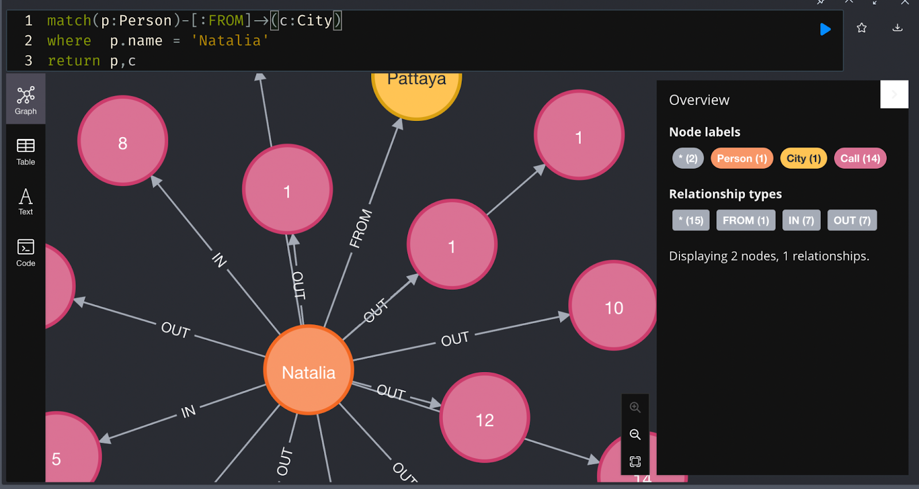
Problem
Showing a persons Natalia’s calls from Pattaya City details:
-Relation
-Condition
-Details

Slide 14
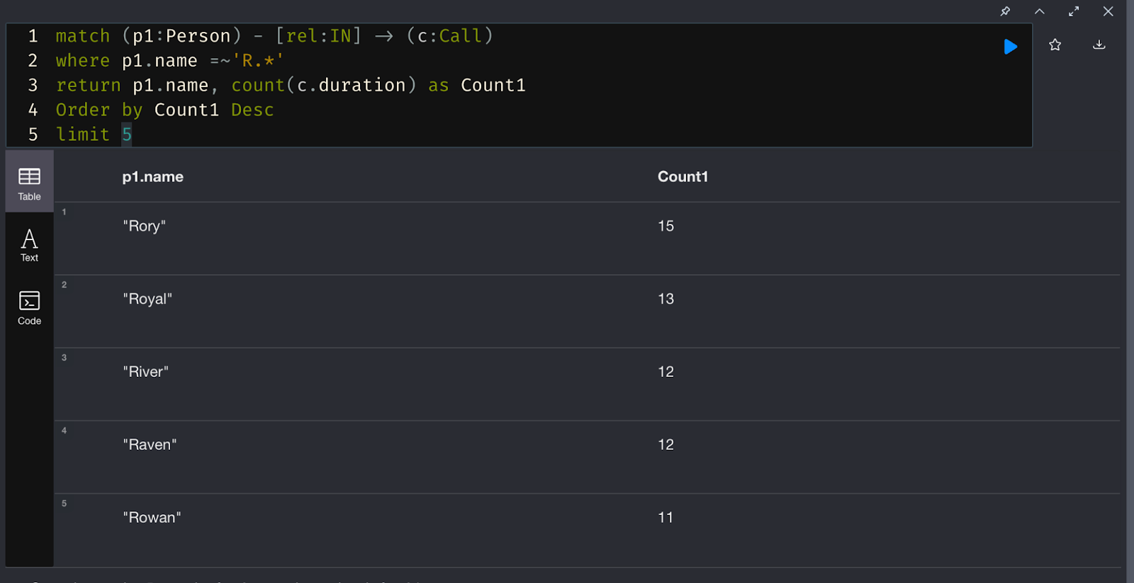
Problem:
Print the name of the person starting with a letter R and total incoming calls counts made by them arranged in Desc.
-Relation
-Condition
-Aggregation
count
- Sequence
-Data Limit

Slide 15
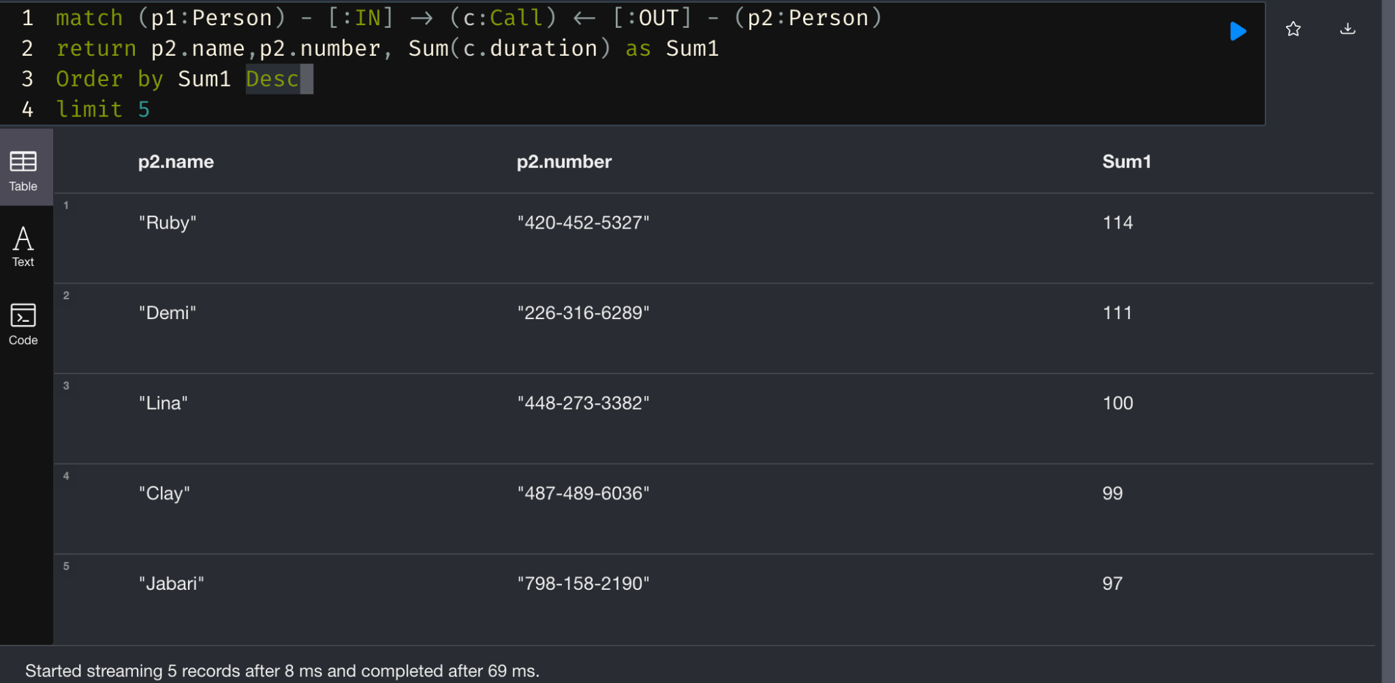
Problem
Print person name, number whose duration sum of out going call is arranged in descending order
-Relation
-Aggregation
sum
-Sequence
-Data limit

Slide 16
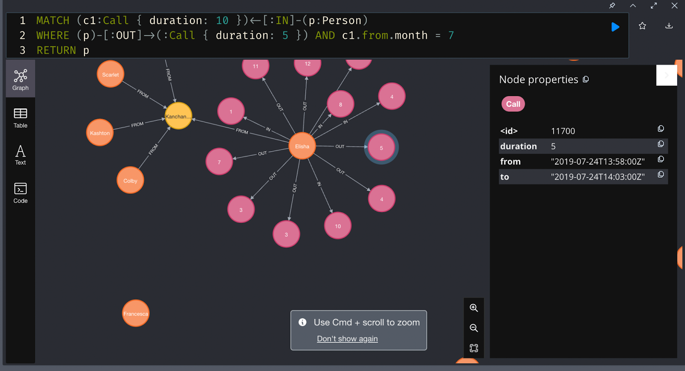
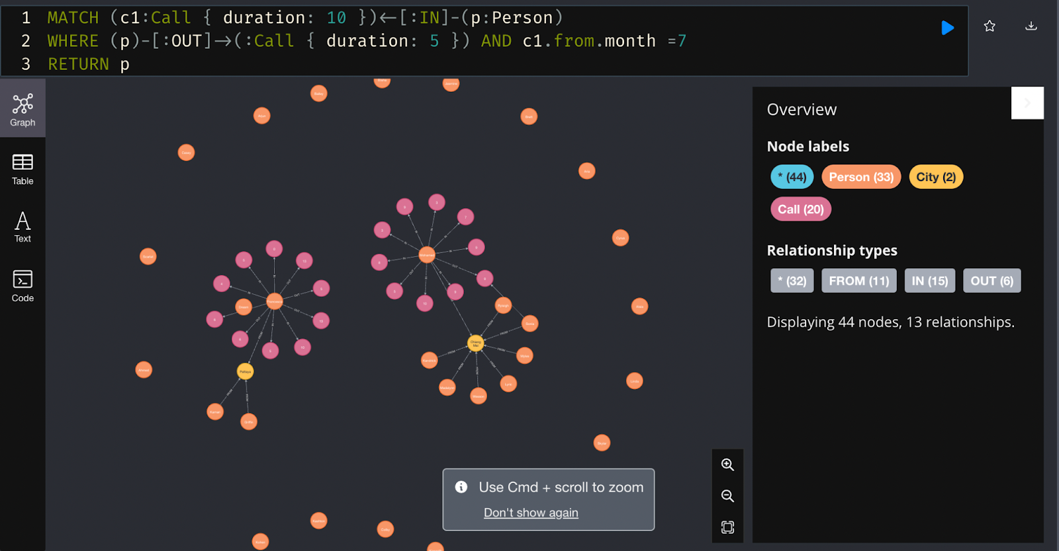
-Relation
-conditions
Problem:
List of Person who made incoming call of duration 10 outgoing call of duration 5 in month of “July”

Slide 17
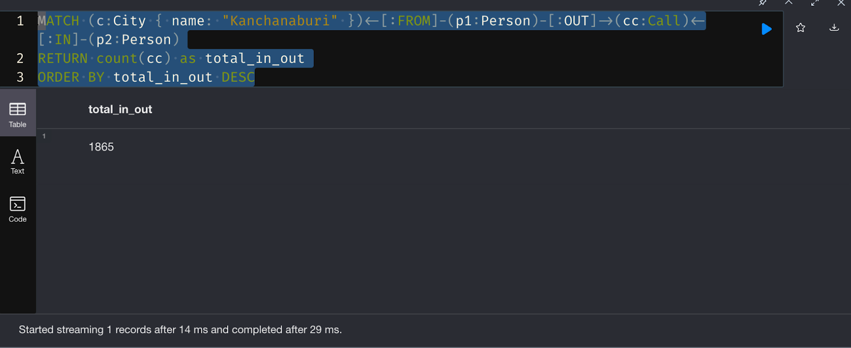
Problem:
Print the total count of calls (in and out) made in city “KANCHANABURI”.
-Relation
-Aggregation
count
- Sequence

Slide 18
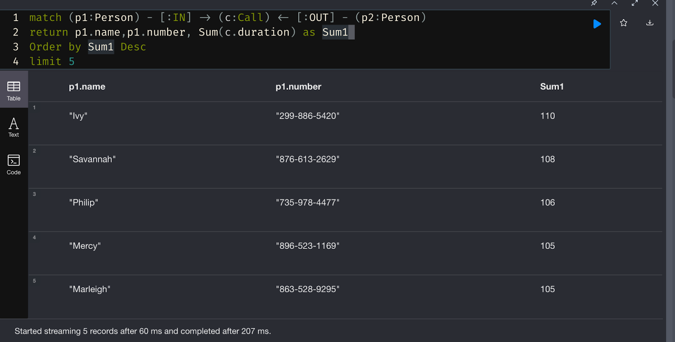
Problem
Print person name, number whose duration sum of incoming call is arranged in descending order.
-Relation
-Aggregation
sum
-Sequence
-Data limit

Slide 19
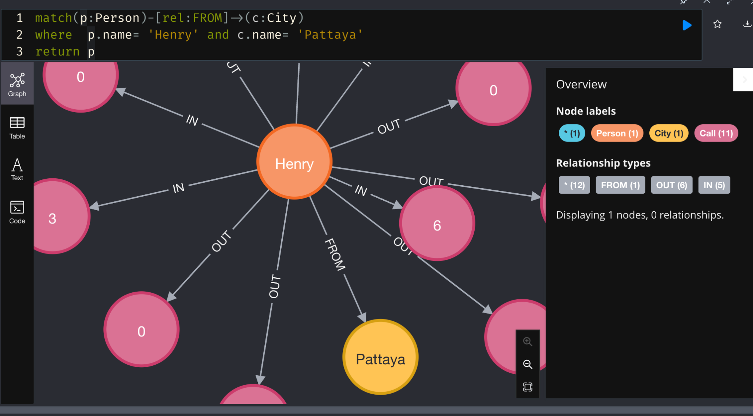
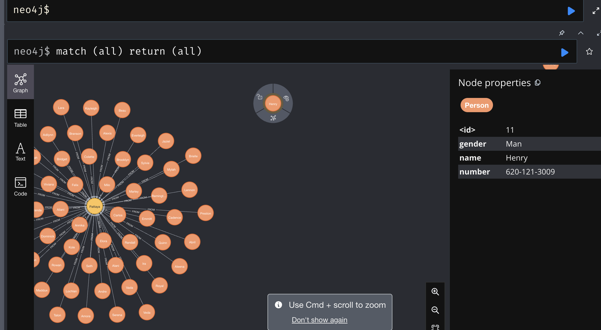
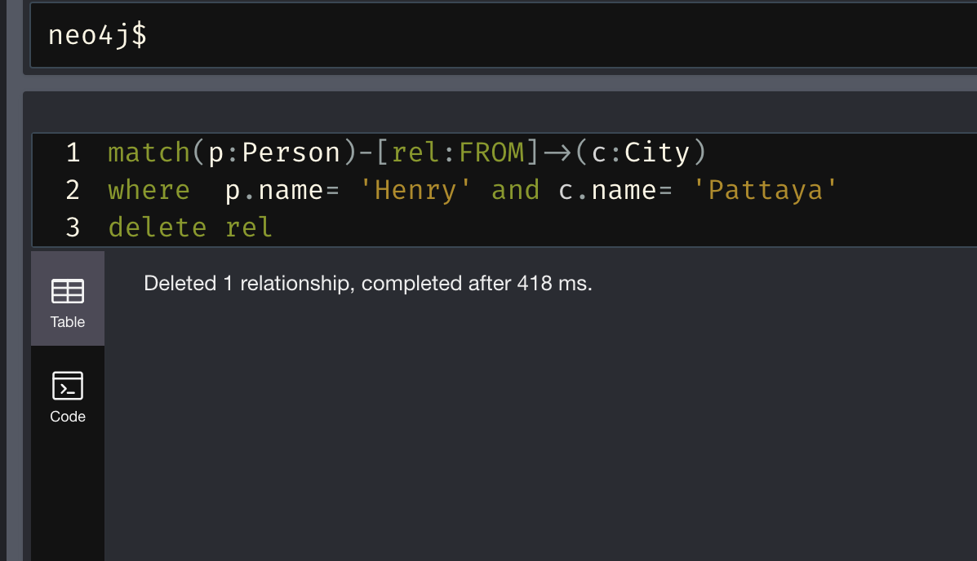
Problem
Delete the relation of person “Henry” from its City “Pattaya.
-Transform data (by deleting a relation)

Slide 20
Conclusion:
We have worked on Call history Database and performed query with Neo4J platform.
Each queries has different operation depend on problem statement and some queries to gain the information of particular nodes.
In nutshell, we have understood how to gain insight while working on structured and unstructured data with graphical representation.

Slide 21
Reference links:
Reference links:
Dataset from Bitbucket data centre. https://vbatush.bitbucket.io/log_of_calls.csv
Studied from:
Neo4j website:https://neo4j.com/blog/neo4j-call-detail-records-analytics/
Youtube channel: https://www.youtube.com/watch?v=zNUzkvptw8E&list=PLqfPEK2RTgChcOZ6qHgSfwiBPCz2Bzdjh&ab_channel=SatishCJ

Slide 22
Task | Self Assessment
Select the problem / Define the problem | Done
Explain how Graph Data base is best fit for your problem | Done
Model your Graph Data base | Done
Create Nodes, properties for nodes, label them and define the relationships between the nodes | Done
Cleanse your data if there are any null values | Done
Transform your data | Done
Perform aggregation operations. | Done
Query your data base | Done

